Slide 1

I/O Virtualization
Hwanju Kim

Slide 2
I/O Virtualization
Two ways of I/O virtualization
I/O virtualization in VMM
Rewritten Device drivers in VMM
+ High performance
- High engineering cost
- Low fault tolerance (driver bugs)
Hosted I/O virtualization
Existing device drivers in a host OS
+ Low engineering cost
+ High fault tolerance
- Performance overheads
Guest VM
Guest VM
VMM
Block
device driver
Network
device driver
HW
Block device
Network device
Privileged VM
or Host OS
Guest VM
Guest VM
Block
device driver
Network
device driver
VMM
Most VMMs (except VMware ESX Server) adopt
hosted I/O virtualization
HW
Block device
Block device

Slide 3
I/O Virtualization
I/O virtualization-friendly architecture
I/O operations are all privileged and trapped
Programmed I/O (PIO), memory-mapped I/O (MMIO), direct memory access (DMA)
Naturally full-virtualizable
“Trap-and-emulate”
Issues
1. How to emulate various I/O devices
Providing a VM with well-known devices (e.g., RTL8139, AC97) as virtual devices
Existing I/O device emulators (e.g., QEMU) handle the emulation of well-known devices
2. Performance overheads
Reducing trap-and-emulate cost with para-virtualization and HW support

Slide 4


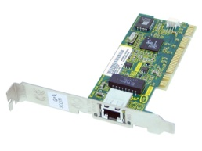
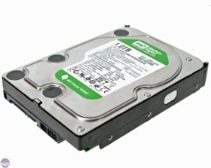
Full-virtualization
Trap-and-emulate
Trap → hypervisor → I/O emulator (e.g., QEMU)
Every I/O operation generates trap and emulation
Poor performance
Example: KVM
I/O operation
Host OS
(Linux)
QEMU
Guest VM
MMIO or PIO
I/O emulation
Guest OS
vCPU
vCPU
User space
Interrupt
Trap
Kernel space
KVM (kernel module)
Native drivers

Slide 5
Para-virtualization
Split driver model
Front-end driver in a guest VM
Virtual driver to forward an I/O request to its back-end driver
Back-end driver in a host OS
Request a forwarded I/O to HW via native driver
I/O operation
Host OS
(Linux)
QEMU
Guest VM
VirtIO
Backend
Shared descriptor ring: Optimization by batching I/O requests
Reducing VMM
intervention cost
Guest OS
VirtIO
Frontend
User space
vCPU
vCPU
Kernel space
KVM (kernel module)
Native drivers

Slide 6
Para-virtualization
How to reduce I/O data copy cost
Sharing I/O data buffer (DMA target/source memory)
A native driver conducts DMA to guest VM’s memory
For disk I/O and network packet transmission
Xen grant table mechanism
Sec = 7
Dom = 1
REQ = R
GR = 1
DomainU(id=1)
Domain0(id=0)
Dom=0
MFN=6
Flag=R
0
1
2
3
Backend
driver
DMA READ
request
READ Sec 7
to PFN 3
Native
Device driver
0 | 1 | 2 | 3 | 4
0 | 1 | 2 | 3 | 4
Grant table
Response
Physical frame number (PFN)
Machine frame number (PFN)
Foreign Map
to PFN 2
for WRITE
with GR 1
Disk
Unmap
0 | 1 | 2 | 3 | 4 | 5 | 6 | 7 | 8 | 9
Xen
0
1
2
3
Dom=0
MFN=6
Flag=R
Active
Grant table

Slide 7
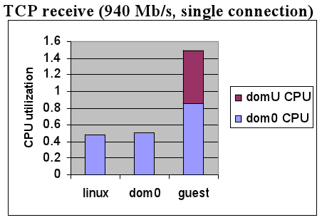
Para-virtualization
How about network packet reception?
Before DMA, VMM cannot know which VM is the destination of a received packet
Unavoidable overhead with SW methods
Two approches in Xen
Page flipping (remapping)
- Zero-copy
Page copying
- Single-copy
Network optimizations for PV guests [Xen Summit’06]
Domain0
DomainU
Domain0
DomainU
Buffer
Buffer
Packet
+ No copy cost
- Map/unmap cost
Packet
+ No map/unmap cost
(some costs before optimization)
- Copy cost
Packet

Slide 8
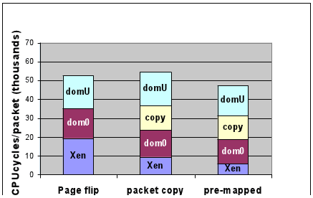
Para-virtualization
Does copy cost outweigh map/unmap cost?
Map/unmap involves several hypervisor interventions
Copy cost is slightly higher than map/unmap (i.e., flip) cost
“Pre-mapped” optimization makes page copying better than page flipping
Pre-mapping socket buffer reduces map/unmap overheads
Page copying is the default in Xen
Network optimizations for PV guests [Xen Summit’06]

Slide 9
Why HW Support?
Why not directly assign one NIC per VM?
NIC is cheap HW
Technically possible
Selectively exposing PCI devices
Giving I/O privilege to guest VMs
Xen isolated driver domain (IDD)
But, unreliable and insecure I/O virtualization
Vulnerable to DMA attack
DMA is carried out with machine addresses
One VM can access another VM’s machine memory via DMA
How to prevent?
Monitoring every DMA request by using memory protection to DMA descriptor regions → Overhead!
Guest VM
Guest VM
Guest VM
VMM
Poor scalability: Slot limitation

Slide 10
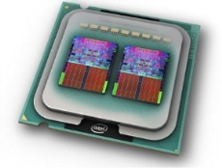
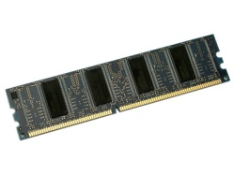
HW Support: IOMMU
I/O Memory Management Unit (IOMMU)
Presenting a virtual address space to an I/O device
IOMMU for direct I/O access of a VM: Per-VM address space
Virtual address
Virtual address
Level 2
Page
table
Physical memory
MMU
Page
table
Page
table
Level 2
Page
table
IOMMU
Page
table
. . .
Page
table
Page
table
Level 1
Page
table
Page
table
Level 1
Page
table
Intel VT-d
AMD IOMMU
ARM SMMU
Secure direct I/O device access

Slide 11
How to Deal with HW Scalability
How to directly assign NICs to tens of hundreds of VMs consolidated in a physical machine?
PCI slots are limited
Can a single NIC support multiple VMs separately?
A specialized device for virtualized environments
Multi-queue NIC
CDNA
SR-IOV

Slide 12
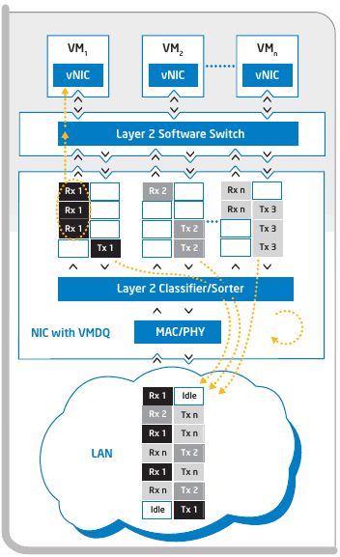
HW Support: Multi-queue NIC
Multi-queue NIC
A NIC has multiple queues
Each queue is mapped to a VM
L2 classifier in HW
Reducing receive-side overheads
Drawback
L2 SW switch is still need
e.g., Intel VT-c VMDq
Enhance KVM for Intel® Virtualization
Technology for Connectivity [KVMForum’08]

Slide 13
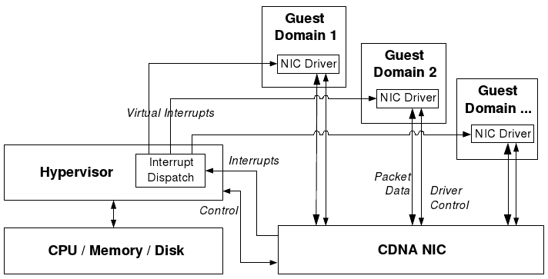
HW Support: CDNA
CDNA: Concurrent Direct Network Access
Rice Univ.’s project
Research prototype: FPGA-based NIC
SW-based DMA protection without IOMMU
Concurrent Direct Network Access in Virtual Machine Monitors [HPCA’07]

Slide 14
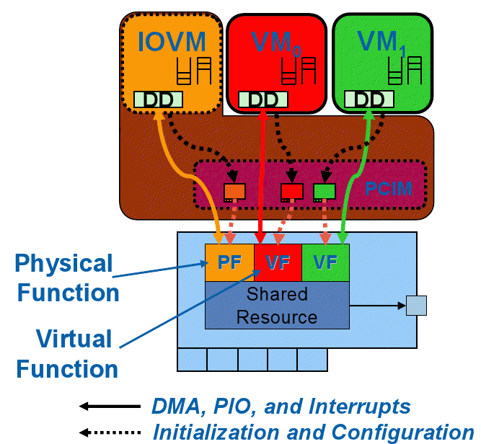
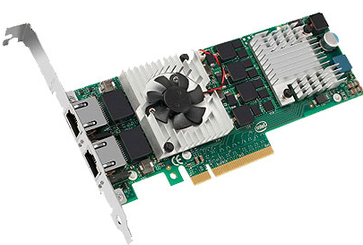
HW Support: SR-IOV
SR-IOV (Single Rooted I/O Virtualization)
PCI-SIG standard
HW NIC virtualization
Virtual function is accessed as
an independent NIC by a VM
No VMM intervention in I/O path
Intel 82599 10Gb NIC
Source: http://www.maximumpc.com/article/maximum_it/intel_launches_industrys_first_10gbaset_server_adapter
Enhance KVM for Intel® Virtualization
Technology for Connectivity [KVMForum’08]

Slide 15
Network Optimization Research
Architectural optimization
Diagnosing Performance Overheads in the Xen Virtual Machine Environment [VEE’05]
Optimizing Network Virtualization in Xen [USENIX’06]
I/O virtualization optimization
Bridging the Gap between Software and Hardware Techniques for I/O Virtualization [USENIX’08]
Achieving 10 Gb/s using Safe and Transparent Network Interface Virtualization [VEE’09]

Slide 16
Inter-VM Communication
Analogous to inter-process communication (IPC)
Split driver model has unnecessary path for inter-VM communication
Dom1 → Dom0 (bridge) → Dom2
Xen network architecture
vif1.0
Dom1
Dom2
Dom0
Bridge
eth0
eth0
vif2.0
eth0
VMM
H/W

Slide 17
Inter-VM Communication
High-performance inter-VM communication based on shared memory
Research projects
Depending on which layer is interposed for inter-VM communication
XenSocket [Middleware’07]
XWAY [VEE’08]
XenLoop [HPDC’08]
Fido [USENIX’09]

Slide 18
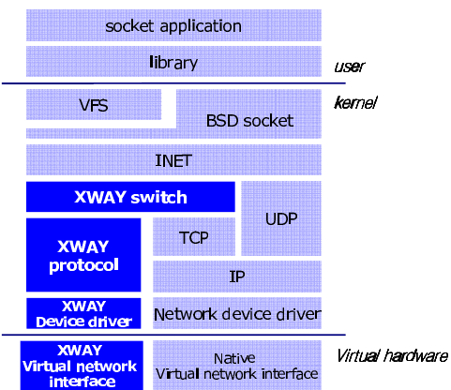
Inter-VM Communication: XWAY
XWAY
Socket-level inter-VM communication
Inter-domain socket communications supporting high performance and full binary compatibility on Xen [VEE’08]
Interface based on
shared memory

Slide 19
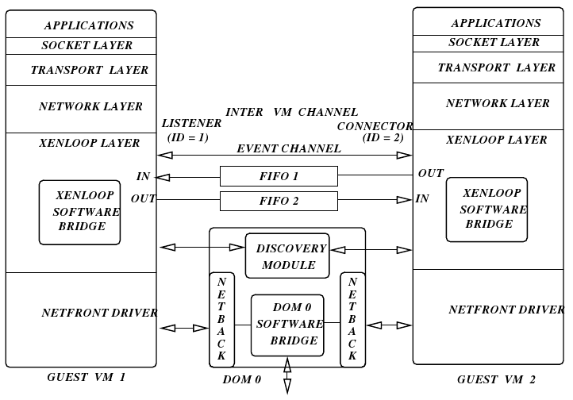
Inter-VM Communication: XenLoop
XenLoop
Driver-level inter-VM communication
XenLoop: a transparent high performance inter-vm network loopback [HPDC’08]
Module-based
implementation
→ Practical

Slide 20
Summary
I/O virtualization
Focused on reducing performance overheads
Network virtualization overhead matters in 10Gbps network
Prevalent paravirtualized I/O
Module-based split driver model has been adopted in mainline
HW support for I/O virtualization
SR-IOV NIC & IOMMU mostly eliminates I/O virtualization overheads

Slide 21
GPU Virtualization

Slide 22
GPU is I/O device or Computing unit?
Traditional graphics devices
GPU as an I/O device (output device)
Framebuffer abstraction
Exposing screen area as a memory region
2D/3D graphics acceleration
Offloading complex rendering operations from CPU to GPU
Library: OpenGL, Direct3D
Why offloading?
Graphics operations are massively parallel in a SIMD manner
GPU is a massively parallel device with hundreds of cores
Why not a computing device?
General-purpose GPU (GPGPU)
Not only handling graphics operations, but also processing general parallel programs
Library: OpenCL, CUDA

Slide 23
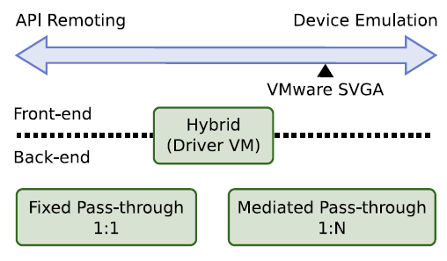
GPU Virtualization
SW-level approach
GPU multiplexing
A GPU is shared by multiple VMs
Two approaches
Low-level abstraction: Virtual GPU (device emulation)
High-level abstraction: API remoting
HW-level approach
Direct assignment
GPU pass-through
Supported by high-end GPUs
GPU Virtualization on VMware’s Hosted I/O Architecture [OSR’09]

Slide 24
SW-Level GPU Virtualization
Virtual GPU vs. API Remoting
 | Virtual GPU | API remoting
Method | Virtualzation at GPU device level | Virtualiztion at API level (e.g., OpenGL, DirectX)
Pros | Library-independent | VMM-independent GPU-independent
Cons | VMM-dependent GPU-dependent → Most GPUs are closed and rapidly evolving, so virtualization is difficult | Library-dependent But, a few libraries (e.g., OpenGL, Direct3D) are prevalently used (# of libraries < # of GPUs)
Use case | Base emulation-based virtualization (e.g., Cirrus, VESA) | Guest extensions used by most VMMs (Xen, KVM, VMware)

Slide 25
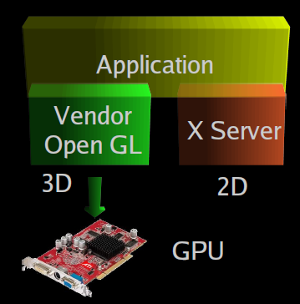
API Remoting: VMGL
OpenGL apps in X11 systems
VMGL: VMM-Independent Graphics Acceleration [XenSummit’07, VEE07]

Slide 26
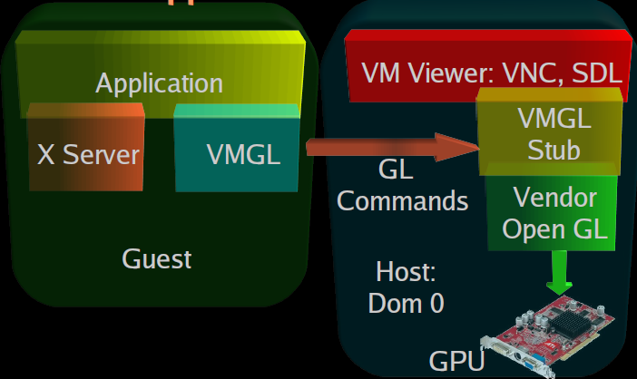
API Remoting: VMGL
VMGL apps in an X11 guest VM
VMGL: VMM-Independent Graphics Acceleration [XenSummit’07, VEE07]

Slide 27
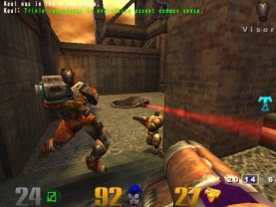
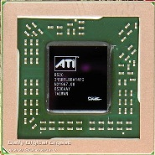
API Remoting: VMGL
VMGL on KVM
API remoting is VMM-independent
WireGL protocol provides efficient 3D remote rendering
Viewer
QEMU
Guest VM
Quake3
VirtIO-Net
Backend
VMGL
Library
X Server
VMGL stub
Guest OS
VirtIO-Net
Frontend
Host OS
(Linux)
KVM (kernel module)

Slide 28
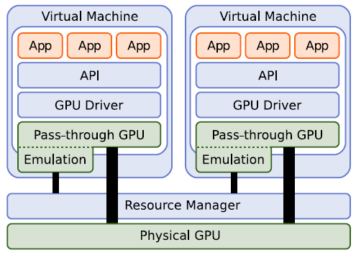
HW-Level GPU Virtualization
GPU pass-through
Direct assignment of GPU to a VM
Supported by high-end GPUs
Two types (defined by VMware)
Fixed pass-through 1:1
High-performance, but low scalability
Mediated pass-through 1:N
GPU provides multiple context,
so a set of contexts can be directly assigned to
each VM
GPU Virtualization on VMware’s Hosted I/O Architecture [OSR’09]

Slide 29

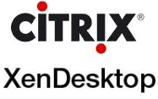


Remote Desktop Access: Industry
Remote desktop access technologies for high UX
Citrix HDX
Microsoft RemoteFX
Teradici PCoIP (PC-over-IP)
VDI solutions
VMware View with PCoIP
VMware ESXi + PCoIP
Citrix XenDesktop
Xen + HDX + RemoteFX
Microsoft VDI with RemoteFX
Hyper-V + RemoteFX
VirtualBridges VERDE VDI
KVM + SPICE

Slide 30
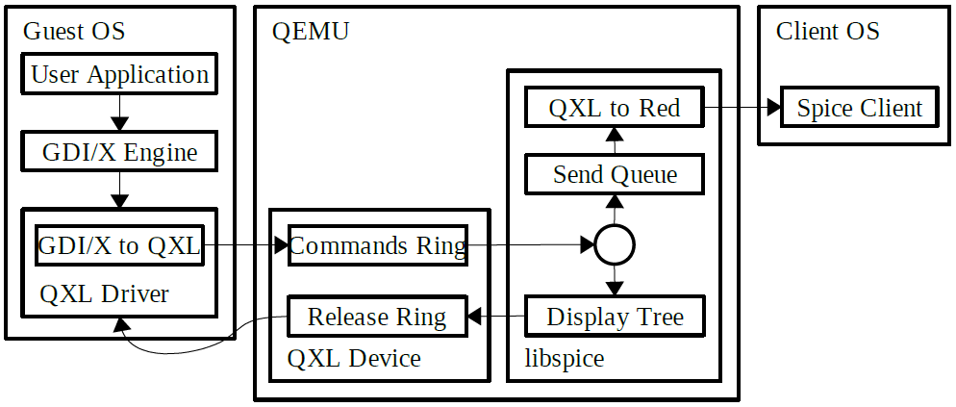
Remote Desktop Access: Open Source
SPICE
Remote interaction protocol for VDI
Optimized for virtual desktop experiences
Actively developed by Redhat
Based on KVM

Slide 31
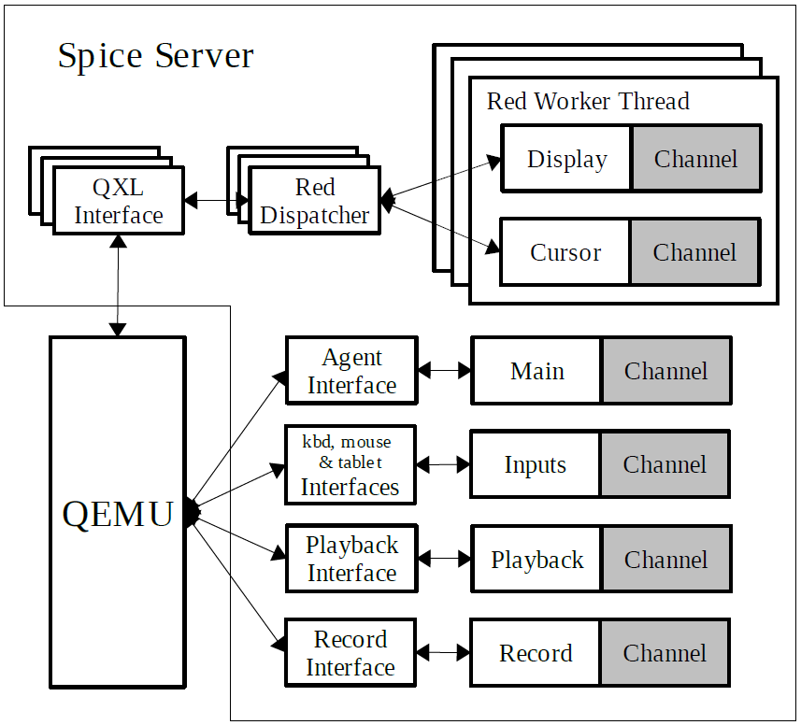
Remote Desktop Access: Open Source
SPICE (cont’)
Separate display thread per VM
(display rendering parallelization)
A VM (KVM) =
I/O thread (QEMU main)
+ Display thread
+ VCPU0 thread
+ VCPU1 thread
…

Slide 32
Summary
GPU virtualization
GPU is mostly closed
Low-level GPU virtualization is technically complicated
Instead, high-level abstraction well hides underlying complexity
API remoting is an appropriate solution
GPU is not only for client devices, but also for servers
Virtual desktop infrastructure (VDI)
GPU instance provided by public clouds
Cluster GPU Instances for Amazon EC2

